Slide 1
Object-Oriented Programming
WEEK 12 Abeeha Sattar

Slide 2
Exception Handling
Examples only

Slide 3
std::bad_alloc
#include <iostream>
#include <exception>
using namespace std;
int main () {
try {
int* myarray= new int[1000000000000000];
} catch (std::bad_alloc& e) {
cout << "Standard exception: " << e.what() << endl;
}
return 0;
}

Slide 4
std::bad_cast
#include <iostream> // std::cout
#include <typeinfo> // std::bad_cast
class Base {virtual void member(){}};
class Derived : Base {};
int main () {
try {
Base b;
Derived& rd = dynamic_cast<Derived&>(b);
}
catch (std::bad_cast& bc) {
std::cerr << "bad_cast caught: " << bc.what() << '\n';
}
return 0;
}
Notes:
Std::cerr
The c stands for character
The err stands for error
Std::cerr is character error stream

Slide 5
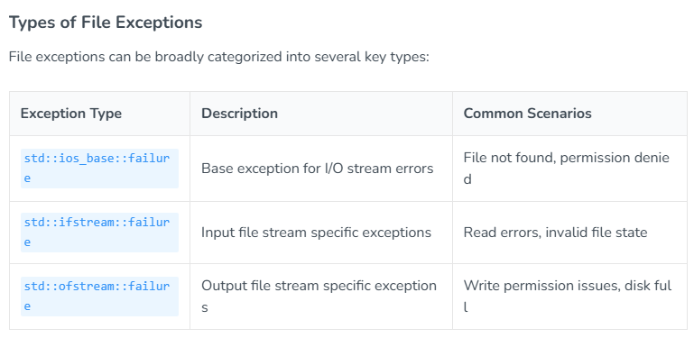
Types of File Exceptions
Notes:
https://labex.io/tutorials/cpp-how-to-resolve-file-operation-exceptions-434188

Slide 6
Stream Validation
#include <fstream>
#include <iostream>
void checkStreamState(const std::string& filename) {
std::ifstream file(filename);
// Check various stream state flags
if (file.fail()) {
std::cerr << "File opening failed" << std::endl;
}
if (file.bad()) {
std::cerr << "Unrecoverable stream error" << std::endl;
}
if (file.eof()) {
std::cerr << "End of file reached" << std::endl;
}
}
Notes:
https://labex.io/tutorials/cpp-how-to-resolve-file-operation-exceptions-434188

Slide 7
File Validation
#include <fstream>
#include <iostream>
#include <stdexcept>
class FileErrorHandler {
public:
static bool validateFileOperation(const std::string& filename) {
try {
std::ifstream file(filename);
// Multiple error detection mechanisms
if (!file.is_open()) {
throw std::runtime_error("Cannot open file");
}
// Additional file validation
file.exceptions(std::ifstream::failbit | std::ifstream::badbit);
// Perform file content validation
std::string line;
if (!std::getline(file, line)) {
throw std::runtime_error("Empty or unreadable file");
}
return true;
}
catch (const std::exception& e) {
std::cerr << "File Error: " << e.what() << std::endl;
return false;
}
}
};
int main() {
std::string testFile = "/path/to/test/file.txt";
bool isValid = FileErrorHandler::validateFileOperation(testFile);
std::cout << "File Validation Result: "
<< (isValid ? "Success" : "Failure")
<< std::endl;
return 0;
}
Notes:
https://labex.io/tutorials/cpp-how-to-resolve-file-operation-exceptions-434188

Slide 8
Fin.
: )

